Slide 1

ARMY BOXING ASSOCIATION
ANNUAL CONFERENCE
SEPTEMBER 2019

Slide 2
Programme
UPDATE ON PREVIOUS YEAR
REGISTRATION ADMINISTRATION
TRAINING
LUNCH
MEDICAL MANAGEMENT OF SERVICE BOXING
COMPETITION MANAGEMENT AND FORMATS
MAJOR PANEL OF OFFICIALS MEETING

Slide 3
REGISTRATIONS
Total registered – 1563 (1862) (2056)
Service only boxers – 1387 (1652) (1868)
England boxing – 176 (210) (188)

Slide 4
COACHES
Qualified
Level 1 – 284 (282)
  16 courses
Level 2 – 60 + 27 refresh
  - 4 failures
  – 6 courses
Total qualified- 371
Registered
Level 1 – 261 (294) (320)
Level 2 – 151 (152) (117)
Total registered – 412 (446) (437)

Slide 5
OFFICIALS
Qualified
6 courses were run in qualifying 63 (65) Judge & Timekeepers
Registered
A total of 183 officials registered for the season (167)

Slide 6
AFFILIATIONS
74 Units affiliated to the Army Boxing Association for the season (63) (67)
Army Boxing Licensed 55 (61) boxing championships amounting to 110 (121) days of boxing. (64 / 141)

Slide 7
INTER UNIT COMPETITION
¼ FINALS
3 PARA V 4 SCOTS
1 RRF V 5 RIFLES
13 AASp Regt RLC
2 Rifles
½ FINALS
13 AA Sp Regt RLC V 2 Rifles
1 RRF V 3 PARA

Slide 8
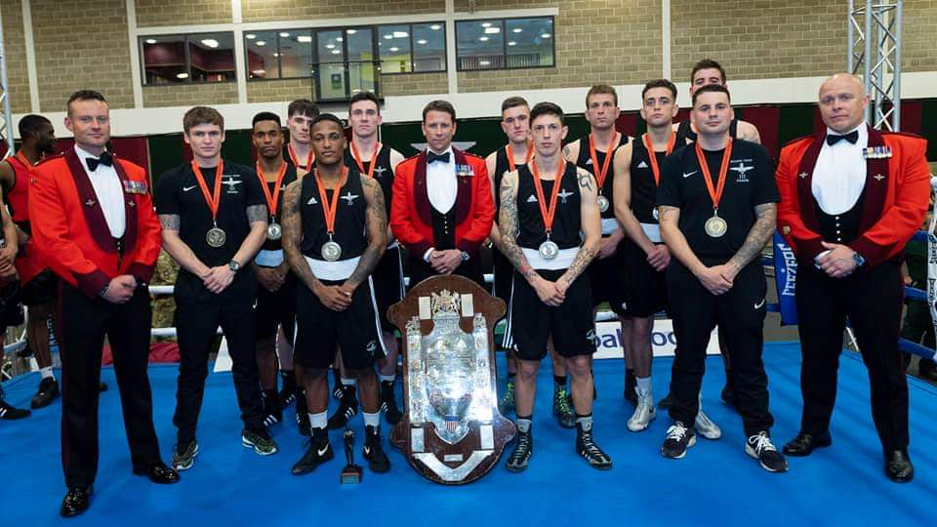
ARMY INTER UNIT CHAMPIONSHIPS

Slide 9
INDIVIDUAL HONOURS
3 X Army Boxers on GB Podium
1 x Army Boxer on Philippines Squad
2 X Army Boxers at World Champs in India
  Sapper Ebonie Jones Eng 51kg
  LCpl Megan Reid Scot 64kg
Gunner Karris Artingstall 2 x Gold Medals at
  Latvia Box Cup
  Strandja Box Cup

Slide 10
INDIVIDUAL HONOURS
ASIA Championships Silver
  LCpl Marvin
World Championships
  LCpl Marvin
European Championships
  Gunner Artingstall Silver
  LCpl Reid
  Gunner Willetts

Slide 11
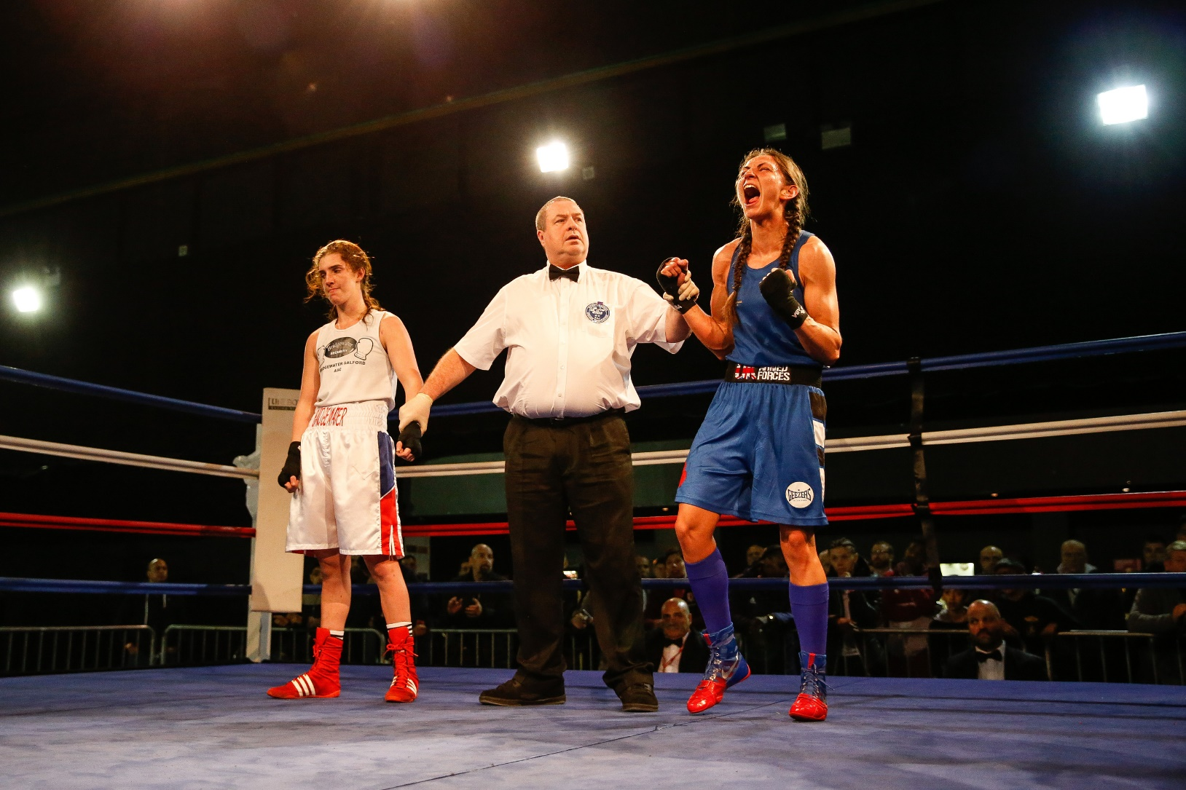

Slide 12
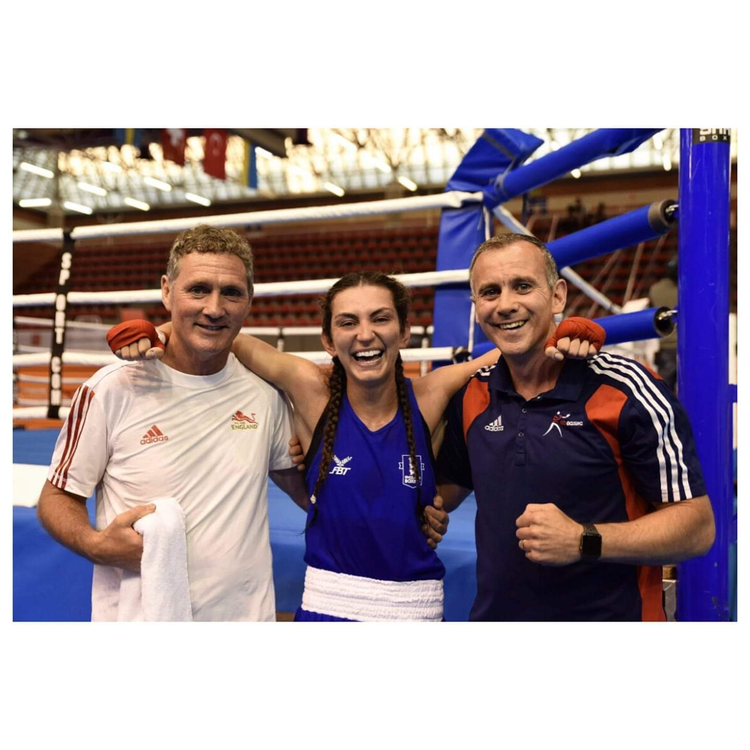

Slide 13
INDIVIDUAL HONOURS
GB Gold
  LCpl Ngwenya 91kg
GB Silver
  Gunner Willets
  51kg LCpl Reid – 64kg
England Gold
  Gunner Willets
  LCpl Ngwenya
Scotland Gold
  LCpl Reid
Wales Gold
  LCpl Morrison

Slide 14
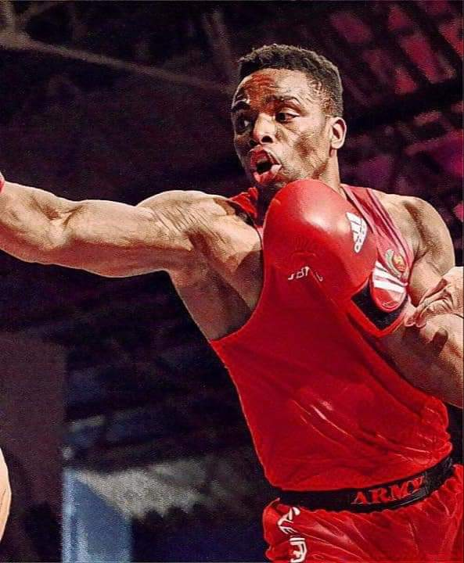

Slide 15
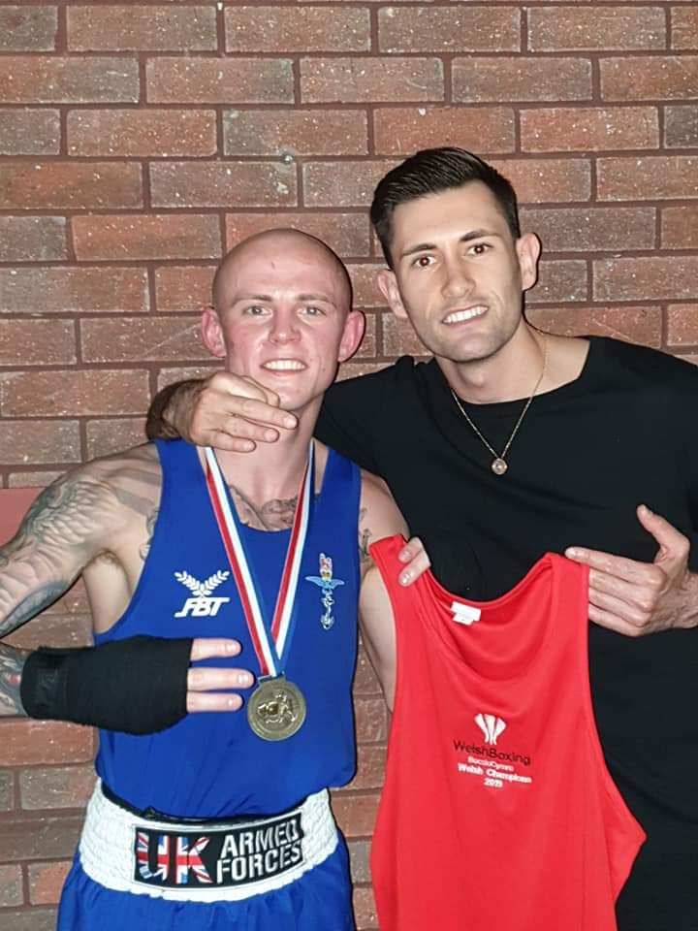

Slide 16
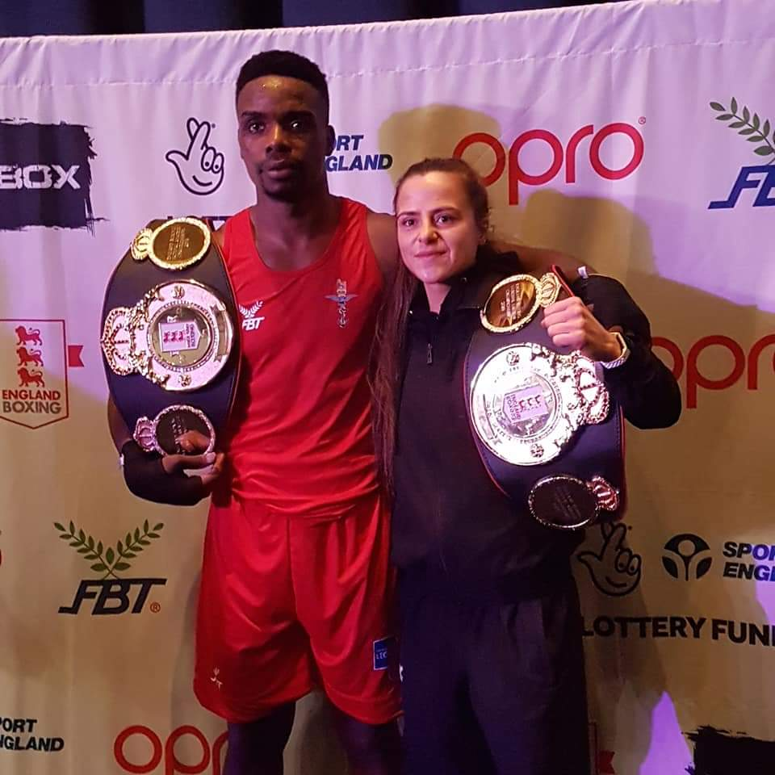

Slide 17
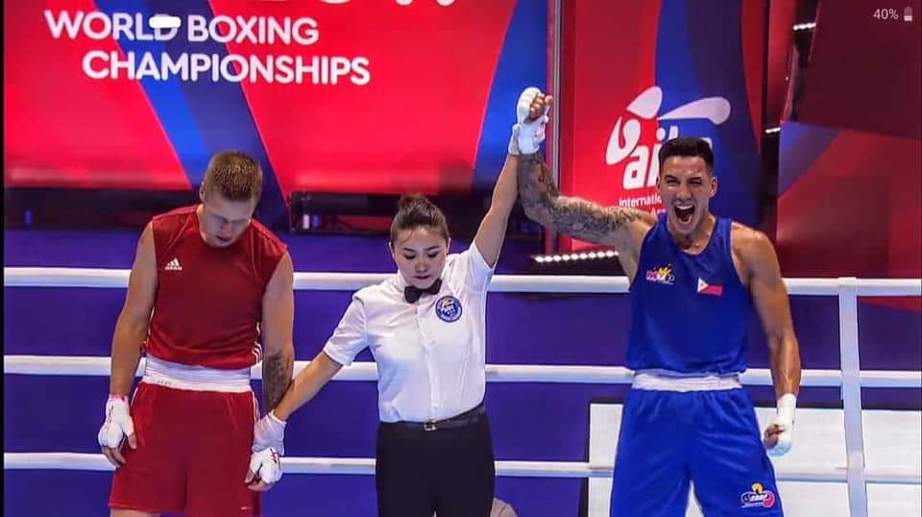

Slide 18
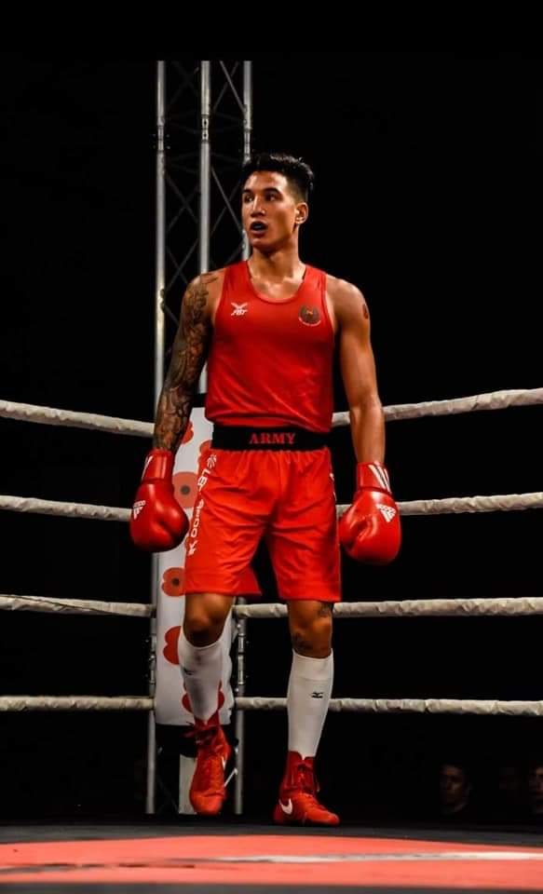

Slide 19
INDIVIDUAL HONOURS
England Development Championships
Gold Medallists
LCpl Brown Class B
LCpl Lee Class A
LCpl McAuley Class A
Silver medallists
Sapper Smith
LCpl Mahoney
Sgt Roberts female

Slide 20
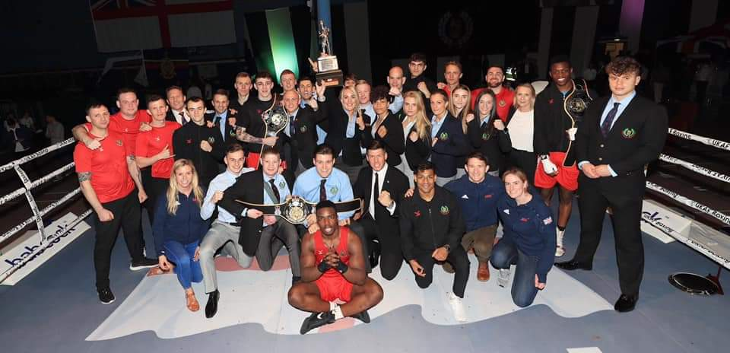
TEAM HONOURS 2009 - 2019

Slide 21
BREAKDOWN OF COST OF ARMY BA
2018/2019

Slide 22
UKAF BOXING HANDBOOK 2019/20

Slide 23
BOXING OFFICER
COMMISSIONED OFFICER
RESPONSIBILITIES
  TO ASSURE ALL BOXING ACTIVITIES AT UNIT LEVEL
    FRAGO 01 to OPO14/002– The Army’s approach to Risk To Life Sport and Adventurous Training.
    REGISTER COACHES
    AFFILIATE UNIT
    BOXING MEDICALS
    BOXING REGISTRATIONS
    TRAINING AT YOUR OWN UNIT
    TRAINING AWAY FROM UNIT GYMS
      MILITARY
      CIVILIAN
    UNIT EMERGENCY MEDICAL PLAN
    INJURY REPORTING

Slide 24
REGISTRATIONS
UNIT
COACHES
BOXERS
OFFICIALS

Slide 25
UNIT AFFILIATION
REGISTER COACHES
  If no Level 2 Coaches what is the plan to manage training plan and sparring.
ADD OFFICIALS (if any)
BOXING RING
  Do the unit own one if not how is Sparring to take place?
CHECK EQUIPMENT
  Do you have enough
  Is it serviceable
CONTACT REGIONAL CHAIRMAN
  Boxing Officer to discuss safe conduct of training and confirm that the coaches are aware of the Unit Emergency Action Plan. Incident Reporting and Risk Assessments.

Slide 26
UNIT AFFILIATION

Slide 27
COACHES QUALIFICATIONS
LEVEL 1
STANDARDISED ENGLAND BOXING QUALIFICATION
The current qualifications and the period of validity of England Boxing coaches are;
Level 1 – Valid for 3 years from the date of qualification, there is a refresher for this qualification. Level 1 coaches MAY upgrade to Level 2 after a minimum period of 1 year with proof of registration and coaching experience.

Slide 28
COACHES REGISTRATIONS

Slide 29
COACHES QUALIFICATIONS
Level 2
STANDARDISED ENGLAND BOXING QUALIFICATION
Valid for 3 years from date of qualification, after which a refresher may be taken, this must be annotated on the Refresher Proforma at Section 7 Annex F. To upgrade to Level 3 a Level 2 Coach must have practised for a minimum period of 2 years and have a recommendation from the Army Boxing Coach.
Any Level 2 coach who has no activity in their registration book or who has not registered for 3 years will revert to Level 1.

Slide 30
COACHES REGISTRATION
a. First Aid at Work Certificate – Valid for 3 years
            OR
b. Mandatory Annual Training Test 3 (Battlefield Casualty Drills) at a minimum of Level 2 – Valid for 1 year.
  AND
SAFEGUARDING
DBS

Slide 31
BOXERS REGISTRATIONS
SERVICE ONLY
BOXING AGAINST CIVILIANS

Slide 32
BOXERS – SERVICE ONLY

Slide 33
REGISTRATION APPLICATION

Slide 34
REGISTRATION - DECLARATION

Slide 35
BOXER – CIVILIAN BOXING

Slide 36
BOXERS REGISTRATION
NEVER BOXED
PREVIOUS INDIVIDUAL CONTACT SPORT EXPERIENCE
PREVIOUSLY REGISTERED
    WITH BOOK
    WITHOUT BOOK

Slide 37
PREVIOUS INDIVIDUAL CONTACT SPORT EXPERIENCE
“Individual Physical Contact Sport” means any of the following sports in any of its forms: Aikido, Boxing, Cage Fighting, Judo, Ju-jitsu, Karate, Kendo, Kickboxing, K-1, Muay thai, MMA, Sambo, Savate, Sumo, Taekwondo, Wrestling, Wushu and Unlicensed or White / Pink Collar Boxing, Professional Boxing or such other sports as may be deemed by AIBA to be an individual physical contact sport.”

Slide 38
LOST CARD
Lost or Misplaced Registration Card
(1) The loss of a Boxing Registration Card will result in an automatic 30 day* suspension, the start date of which shall be when Sec Army BA receives the application for replacement. * This suspension is to investigate the loss and record of the boxers and to ensure any medical suspension that may have been imposed is spent (medical suspensions are annotated in a boxers record book and are not routinely transferred to a soldiers Medical Documents).
A thorough search including contacting civilian clubs or previous units must be undertaken.
A letter from the Unit Boxing Officer is required for verification (lost Registration cards will invoke a 30 day exclusion from boxing from the date of receipt of the application by the Army BA).
Follow all the steps for a boxer with no previous experience

Slide 40
COMMANDING OFFICER SIGNATURE

Slide 41
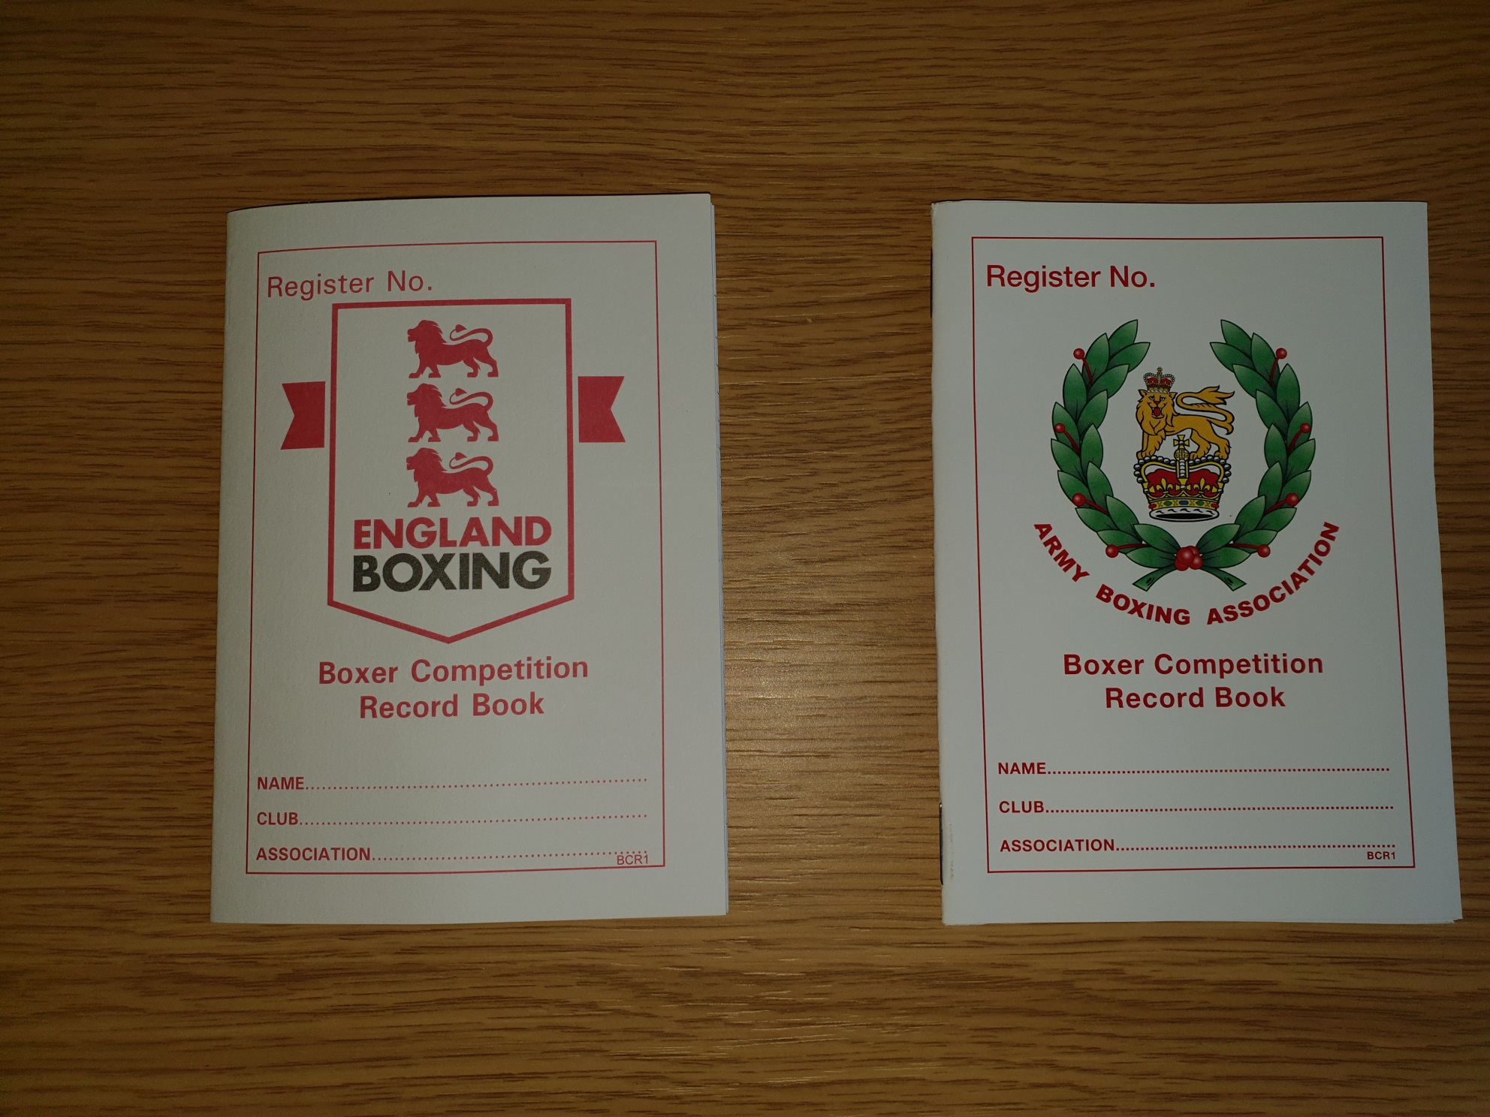

Slide 42
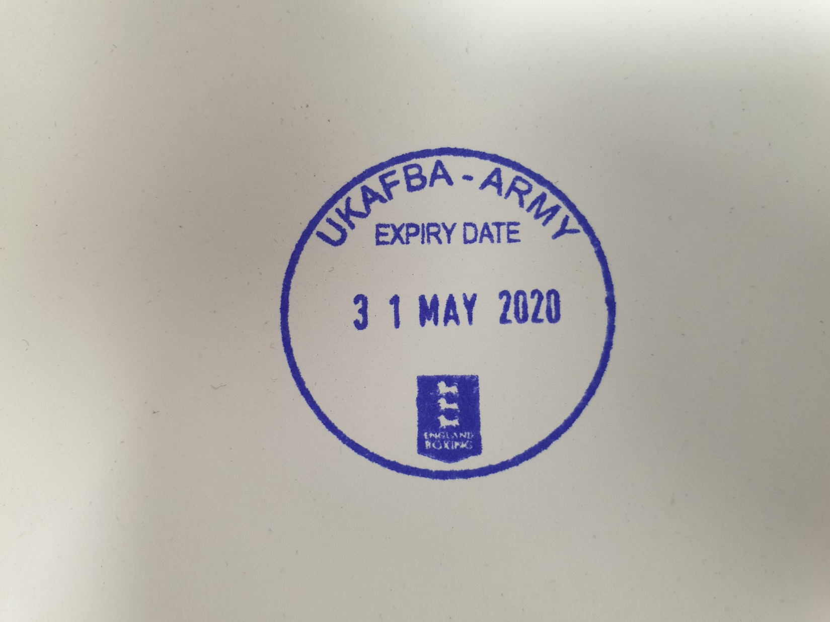
REGISTRATION STAMP
CIVILIAN BOXING

Slide 43
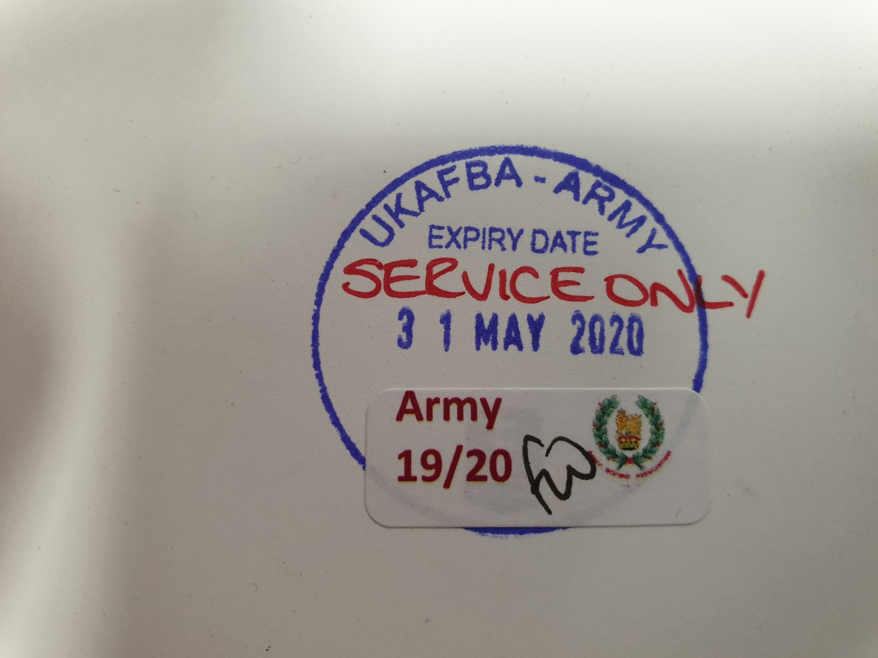
REGISTRATION STAMP
SERVICE ONLY BOXING

Slide 44
ONLINE REGISTRATIONS 2020
VIA VAULT AS PER ENGLAND REGISTRATIONS
SERVICE ONLY
PAYMENT – UNIT INVOICE
DECLARATIONS

Slide 45
ONLINE REGISTRATIONS 2020
TOURNAMENT ADMINISTRATION
  TOURNAMENT RECORD SHEET (DRAG TO LOAD)
  MEDICAL SUSPENSIONS
  IMMEDIATE UPDATE OF RESULTS
REPORTS
GDPR COMPLIANT
TRANSFER TO ENGLAND BOXING FOR CIVILIAN BOXING
OFFICIALS AND COACHES

Slide 46
QUESTIONS

Slide 47
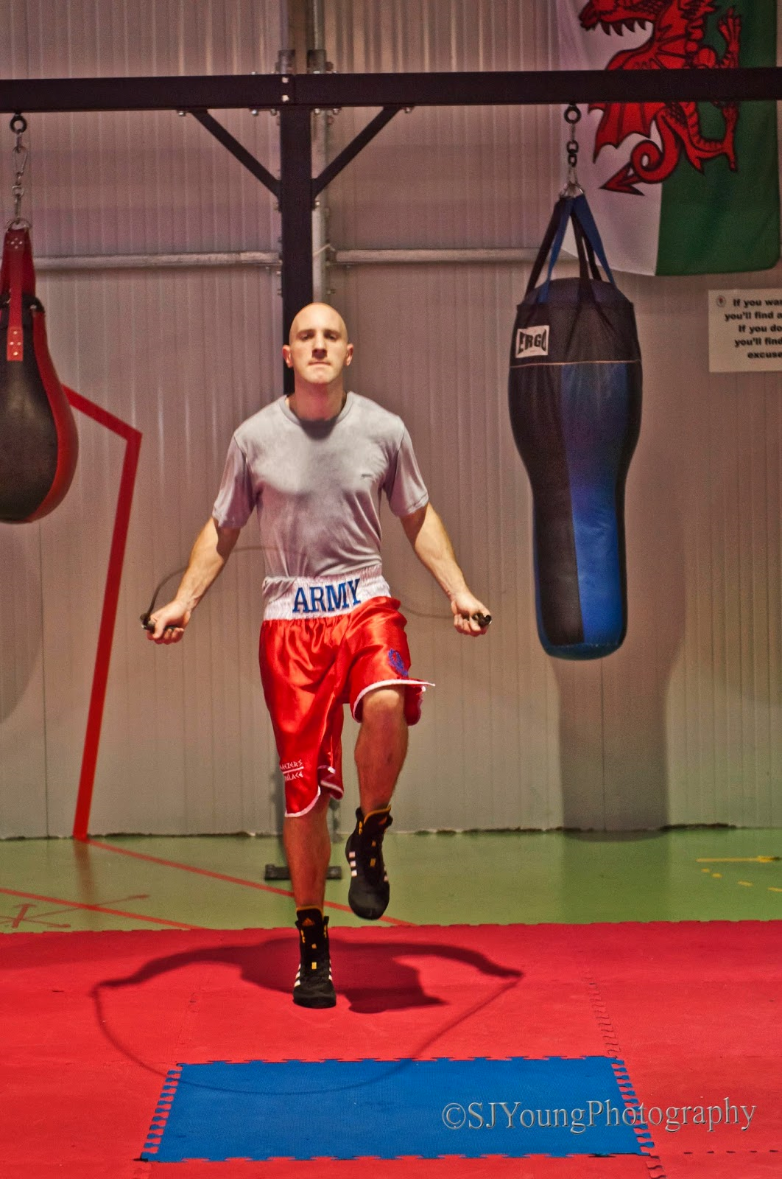
TRAINING

Slide 48
TRAINING
Affiliation
Coaches Registered
Boxers Medicals
Boxers Registered
Training Plan
Risk Assessments

Slide 49
TRAINING
Weight Management
Sparring
Unit Emergency Action Plan
Incident Reporting

Slide 50
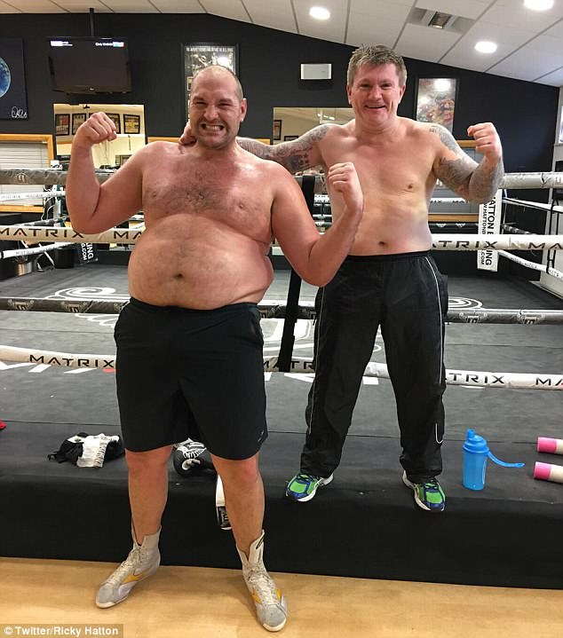
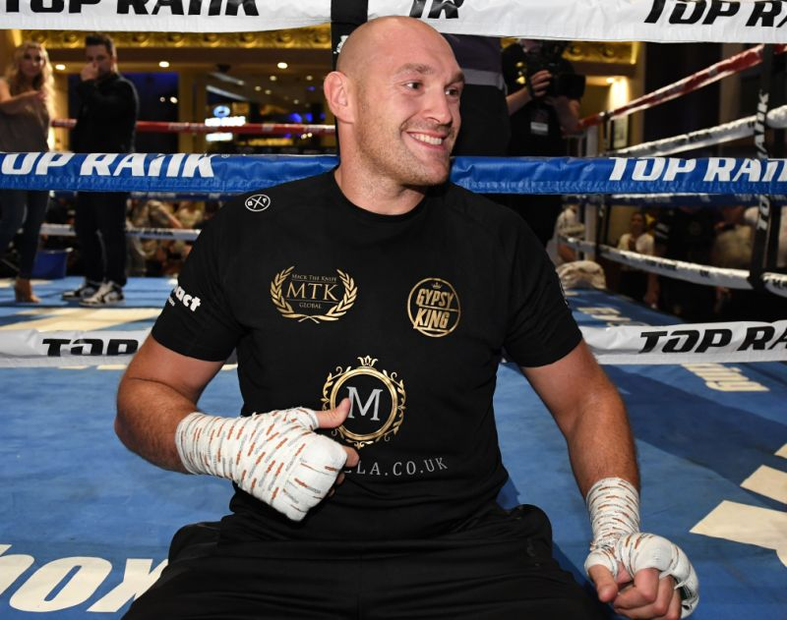
WEIGHT MANAGEMENT

Slide 51
SPARRING
Sparring in Boxing can take several forms as follows
Technique Sparring – where a specific skill is developed. Usually the speed is controlled and the sparring partner acts in a semi passive role, for example, lead hand to the head with a block as a defence. Technique sparring is vital for the beginner. This activity can be done on the gym floor with mass participation, can be supervised by Level 1 and does not need to be logged.

Slide 52
SPARRING
Conditioned Sparring – In conditioned sparring, you set a condition (or several conditions) that each boxer must follow. The speed is more realistic than a technique spar but the power is usually kept quite low. The Sparring is generally aimed at skill development for an individual. Typically 80%of sparring is conditioned.
An example of a conditioned spar is;
Boxer A is only allowed to throw a straight lead or rear hand to the head.
Boxer B may only use hand defences
After a given period the boxers swap roles.
This activity is to be undertaken in a boxing ring it must not involve heavy shots to either boxer and does not require to be logged but must be supervised by a Level 2 Coach all boxers must wear head guards, gum shields, abdominal protectors and sparring gloves.

Slide 53
SPARRING
Open Sparring – where the range of punches and defences are unlimited. Punches and footwork are at full speed. Even in open sparring, the power is reduced. Coach feedback and correction is given on the move so that the flow is uninterrupted. Open sparring is not a contest, it is still a learning experience under conditions which start to approach the intensity of a s contest. This activity must be conducted in a boxing ring where conditions are as to wear head guards, gum shields, abdominal protectors and sparring gloves. This must be logged and closely monitored by Level 2 coach with strict adherence to the unit Risk Assessment.

Slide 54
SPARRING RISK
Hazard Ref | RISK Associated with Hazard (How people may be harmed – type of injury or ill health) | Existing Control Measures (Note 2) | Risk Rating | Additional Controls Required (Note 2) | Review frequency (Note 3)
01 | Death from Brain Injury | Head Guards, Bandage inspections, Abdominal protectors, Qualified England Boxing Level 2 Coach, annual medicals and Fit to box, pre sparring verbal confirmation of boxers consent to Spar are compulsory. Coaches to be qualified and in date and registered with the Army BA. All Boxers are to be registered through the Army BA. Boxers are categorised and matched according to Weight and Experience. 16oz gloves for sparring are compulsory. All Sparring is to be conducted in an approved ring as per the unit affiliation declaration. Coaches are to be aware of the local emergency procedures for their Gymnasium and Camp / Club. | 1 x 3 = 3 | Boxers conducting sparring should only spar to a maximum of 2 x per week and not on consecutive days or a duration of their competitive round duration plus 1 round is recommended. ie Dev A boxer 4 x 2 mins rounds Dev B boxer 4 x 3 mins rounds Elite boxer 5 x 3 mins | Annually
02 | Burst eardrum / Detached Retina / Fractures to hands, face or ribs |  | 2 x 2 = 4 |  | Annually
03 | Bruising injuries to face, hands and ribs. |  | 3 x 1 = 3 |  | Annually
04 | Dehydration | 1 min breaks afforded at end of each round, Rounds only 2 or 3 mins max dependant on Cat of Boxer, max of 5 rounds for any boxer | 2 x 1 = 2 |  | Annually
05 | Muscle injury / strain | All boxers are trained by qualified coaches and have Annual medical to ensure fitness to box | 3 x 1 = 3 |  | Annually
06 | Injury due to faulty or damaged training equipment including Boxing Rings and Boxing attire | Senior Coaches (Level 2 and above) are to inspect all training equipment including the Boxing Ring for serviceability prior to any training taking place | 2 x 1 =3 | All Training Rings held by Units are to be inspected as part of the Affiliation process. | Annually

Slide 55
SPARRING LOG
Srl | Rank Name | No of Rds & duration | Opponent 1 | Opponent 2 | Comments | Boxer Sig
0 | Pte Cooper | 4 x 2 mins | Pte Ali 2 Rds | Pte Frasier 2 Rds | Open Spar, Cooper cut above eye in 4th by elbow. Sparring stopped. Cooper taken to A&E for treatment. | H Cooper
1
2
3
4
5
6
7
8
9

Slide 56
SPARRING ISSUES 2018/19
1 Male / Female in squash court.
2 Headache Med Cen
3 Headache Day off

Slide 57
UNIT EMERGENCY ACTION PLAN

Slide 58
INCIDENT REPORTING

Slide 59
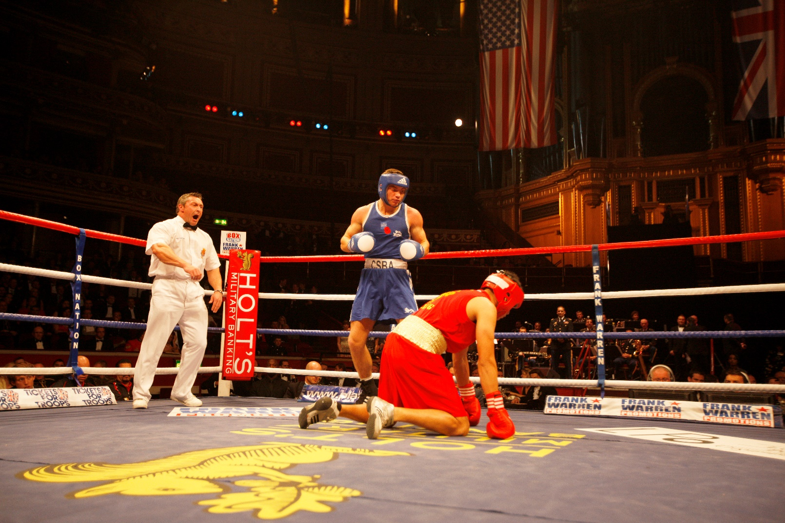
CONCUSSION PROTOCOLS

Slide 60
CONCUSSION PROTOCOL –
19 YRS & ABOVE

Slide 61
CONCUSSION PROTOCOL –
19 YRS & ABOVE

Slide 62
CONCUSSION PROTOCOL –
18 YRS & BELOW

Slide 63
CONCUSSION PROTOCOL –
18 YRS & BELOW

Slide 64
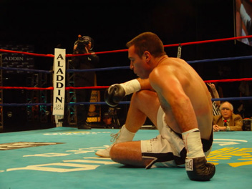
QUESTIONS

Slide 65


Slide 66
INJURY PREVENTION AND MANAGEMENT
RACHEL BUSTIN

Slide 67
COMPETITION PLANNING

Slide 68
COMPETITION PLANNING
Military v Military in a military location
Military boxers v Civilian boxers in a military location
Military boxers v Civilian boxers in a civilian location
Military boxers only in a civilian location
Civilian boxers v Civilian boxers in a military location
CHARITY BOXING EVENTS***

Slide 69
Boxing with Civilians
Against Civilians in Mil location
  Registrations – England Boxing
  Coaches Registrations – England Boxing / DBS
  Officials – England Boxing must include civilian officials / Supervisor
  Notification of Regional Sec
  Commanding Officers Permission
Against Civilians in Civilian location
  As above
  Venue to be licensed.
  Regional Association to provide license for boxing
Mil Boxing in Civilian Location
  Service Only Registration
  License to be agreed
  Supervisor to be agreed
Civilians in Military Location
  Army Boxing to Licence
  Supervisor must be Army BA
  Risk

Slide 70
EVENT PLANNING
Arrange date with Commanding Officer and Regional Sec OR Army BA Sec.
Venue – Suitable and available
  Military or civilian
  Floor
  Seating / Fire
  Lighting – Power supply
  Changing / warm up areas
  Medical room
  Weigh in areas

Slide 71
Competition Format
  Single Day
  Multi Day
  Number and Duration of Bouts
Medical Cover
  Ringside Dr
  Paramedics
Officials
  Contact Regional Secretary
  How many days / How many bouts
Catering
  Internal / External

Slide 72
HOME COUNTRIES
ROYAL REGIMENT OF SCOTLAND BOXING EVENTS
  Boxers registered to England Boxing
  Event in Scotland
    Licensing issues

Slide 73
OVERSEAS
2019 DIN10-001 – OVERSEAS VISITS
2019 DIN10-14 – ARMY SPORTS LOTTERY
DIP CLEAR
PERMISSION TO BOX ABROAD
AIBA AFFILIATED COUNTRIES ONLY
POLITICAL RESTRICTIONS
DIFFERENT NATIONAL RULES

Slide 74

PARAMEDICS AND DRs

Slide 75
PARAMEDICS AND DRs
CONTACT APPROVED COMPANY
  ESSENTIAL QUALIFICATIONS
    CARE QUALITY COMMISSION ACCREDITED
    PRE HOSPITAL EMERGENCY CARE
    ADVANCED TRAUMA LIFE SUPPORT
ARRANGE DATES AND TIMES
  ARMY BA CANNOT PAY FOR LAST MINUTE CANCELLATIONS
PAYMENTS
  ARMY BA LIABILITY TO COVER COSTS

Slide 76
PARAMEDICS CONTACT DETAILS

Slide 77
DRs
RINGSIDE PHYSICIANS
  CONTACT DR WALKER AS EARLY AS POSSIBLE IF A DR CANNOT BE FOUND FROM UNIFORMED SOURCES.

Slide 78
CIVILIAN DR SUPPORT
The Weigh in should be carried out as normal at approx. 0700hrs on the morning of the boxing
When the boxers weigh in they must complete the Pre Bout Medical Form
These forms must then be taken to the Med Cen and a CMT or the Practice Manager MUST check the details on DMICP as declared by the boxers are correct and there are no reasons for them to be excluded from Boxing (this should be arranged at the earliest opportunity to allow the time to be allotted at the Med Cen)
Should all be correct these forms MUST be returned to the Gymnasium and made available to the Dr for the physical medical of the boxers.

Slide 79
CIVILIAN DR SUPPORT
The practice manager or a senior CMT should accompany the Dr throughout their employment to ensure that UKAFBA protocols and policies are adhered to.
Should there be any admission to hospital then a member of the military Med Cen must accompany the boxer.
Any information recorded by the Dr on the evening/day about any boxer or anything found by the Dr or Paramedics on the Post Bout Medical (now compulsory) is to be added to DMICP the following morning.
Any Boxing Medical Suspensions are to be discussed between the Dr and the Appointed Supervisor for agreement and must be in line with the Concussion protocols (Annex D to Section 5) and Medical Suspension Periods (Section 12 Annex E).

Slide 80
ARMY BA COMPETITIONS

Slide 81
ARMY BOXING TEAM
DEV CHAMPS
  CLASS A – NO 56KG ,75KG , 86KG OR 91KG
  CLASS B – NO 86KG 91KG OR 91+KG
FEMALES
  ONLY 4 ENTRIES @
    CLASS A – 48, 51 & 57KG
    CLASS B – 57KG

Slide 82
INDIVIDUAL / INTER CORPS
8 – 11 JUNE
DEV A AND DEV B POINTS SCORING
ELITE AND FEMALE CHAMPIONSHIPS
WEIGHTS AS DETERMINED BY ENGLAND BOXING
POINTS SCORED BY ALL BOXERS
    1 Point per bout boxed plus 1 point if undefeated.

Slide 83
INFANTRY CHAMPS 2020
19 – 22 Oct or 2 – 5 Nov
Aldershot
Format
  5 bouts and Under
  1 entry per unit at any weight.
  Weight Categories (All)
  Points – 1 point for every bout plus 1 if undefeated.
    5 or 6 to count (tbc)
  Not eligible to previous Inter Unit Champions

Slide 84
WOMENS BOX CUP 2021
February
Aldershot
Format
  7 bouts and Under
  8 – 14
  Elite
  Weight Categories (All)

Slide 85
ARMY BOXING CHAMPIONSHIPS
INTER UNIT
  Dev A 2 – 10 bouts
  9 BOXERS
  3 X 2 MINUTE ROUNDS
  Weights
KG | NAME
56 | BANTAM
60 | LIGHT
64 | LIGHT WELTER
69 | WELTER
75 | MIDDLE
81 | LIGHT HEAVY
86 | CRUISER
91 | HEAVY
100 | SUPER

Slide 86
ARMY BOXING CHAMPIONSHIPS 2020
LEAGUE OPTION
6 TEAMS
  POOL A POOL B
    Week 1 A V B 1 V 2
    Week 2 C V A 3 V 1
    Week 3 B V C 2 V 3
Winner Pool A v Runner Up Pool B
Winner Pool B v Runner Up Pool A

Slide 87
ARMY BOXING CHAMPIONSHIPS 2020
LEAGUE OPTION
8 TEAMS
  POOL A POOL B
    Week 1 A V B 1 V 2
    Week 1 C V D 3 V 4
    Week 2 B V C 2 V 3
    Week 2 D V A 4 V 1
    Week 3 D V B 4 V 2
    Week 3 A V C 1 V 3
Winner Pool A v Runner Up Pool B
Winner Pool B v Runner Up Pool A

Slide 88
RECRUITING
    CAPTAIN DAVE GRICE

